Slide 1

STUDENT DETAILS: NAME : SANAM SAIKUMAR SKILLS BUILD EMAIL ID : saikumar25503@gmail.com STUDENT ID : 20F91A0593 COLLEGE : PRAKASAM ENGINEERING COLLEGE COLLEGE STATE : ANDHRAPRADESH INTERNSHIP DOMAIN : FRONT END DEVELOPMENT (FED) START DATE-END DATE : 05/06/2023 – 23/07/2023

Slide 2
PROJECT TITLE : P0RTFOLIO SITE
PROBLEM STATEMENT:
In this presentation, we'll cover each step in creating a sleek and professional portfolio site for your work or business.

Slide 3
AGENDA
In this section, we'll be discussing the structure of the online portfolio site, what it should include and the key elements that will make the site look and work wonderfully.
Homepage
The homepage is the first page that visitors go to when they land on your site. It should introduce you, showcase your work and give an overview of your skills and abilities in an engaging way.
About Me
The about me page introduces yourself to potential clients or employers and shows them why you are the perfect candidate for a particular position. It should be a short introduction that gives potential employers an insight into who you are.
Skills
The skills page is where you showcase your skills by explaining them in detail. Use charts and graphs to visually show your level of experience and expertise.
Portfolio
The portfolio page should showcase your best work samples in a clear and organised layout. It should include clear descriptions, high-quality images, and be easy to use.

Slide 4
Project Overview
Goals
We'll discuss the purpose and objectives of your portfolio.
Design
Producing a visually engaging and user-friendly experience.
Branding
Create a brand identity that showcases your style and personality.
Development
How to develop and build your portfolio site into a seamless user experience.

Slide 5
Who Are the End Users?
Clients
Make a good impression on prospective clients and give them a taste for your work.
Employers
Use your portfolio to land the job of your dreams.
Viewers
Showcase your best work and inspire others in the creative community.

Slide 6
Solution & Presentation
1
Concept
Develop the core concept of your portfolio.
2
Layout
Decide on an intuitive and user-friendly layout that accommodates all your content.
3
Content Strategy
Craft a content strategy that showcases your work and tells your story in the best light.
4
Presentation
Refine the presentation of your portfolio to make it stand out from the crowd.

Slide 7


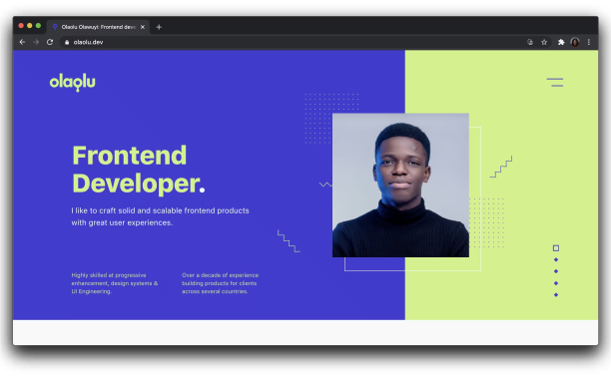
Wow in System
Interior Design Portfolios
Showcase your designs and highlight their aesthetic appeal.
Creative Portfolios
Creatively showcase your work and expertise to impress your audience.
Front-End Development Portfolios
Show your ability not only in the code but also in design aesthetics.

Slide 8
Modeling
1
Consistency
Consistency in using typographies, design elements, images, and branding elements.
2
Simplicity
Simplicity is the ultimate sophistication - choose a simple and clean design concept that doesn't overwhelm the viewer.
3
Functionality
Keep the user experience in mind and make sure there are no glitches or dead-end paths on the site.

Slide 9
Results
Enhanced Visibility
Make your work more visible and accessible to a broader audience.
Showcase Real Projects
Highlight your portfolio in real projects to add life to it.
Improved Reputation
Earn credibility and establish yourself as a thought leader in your respective field.

Slide 10
Links
LinkedIn | linkedin.com/in/
GitHub | github.com/

